Slide 1
Chapter 11: Working with Alignment Data
Li Lei
08/12/2016
Applied Bioinformatics Discussion

Slide 2
Next Generation Sequencing Data Upstream Handling
Raw reads
Aligned reads
Variants
FastQ
BAM, SAM
VCF

Slide 3
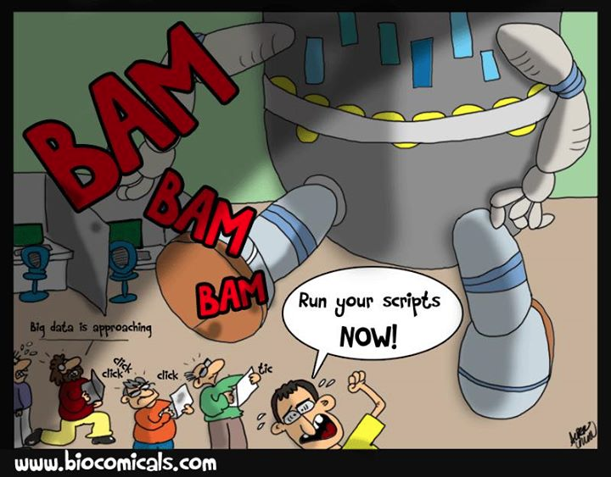
SAM or BAM
SAM: Sequence Alignment Mapping format
BAM: Binary analog of SAM
Notes:
Store a large amount of alignment data.
Almost all of the NGS data analysis includes alignment step, this need an efficient format to store the aligned reads.
You can not directly view BAM because it is a binary file.

Slide 4
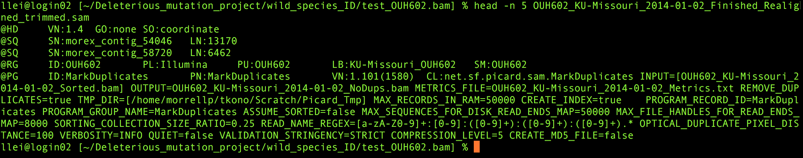
SAM headers
Notes:
VN: format version; GO: grouping of alignments, indicating that similar alignment records are grouped together but the file is not necessarily sorted overall.
SO: sorting order of alignments, based on the coordinate or
@SQ: reference information
@RG: reads group: ID: group ID. And PL: plant form PU: plant unit(e.g.flow-cell-barcode.lane) LB:” library SM: sample; use pool name where a pool is being sequenced.

Slide 6
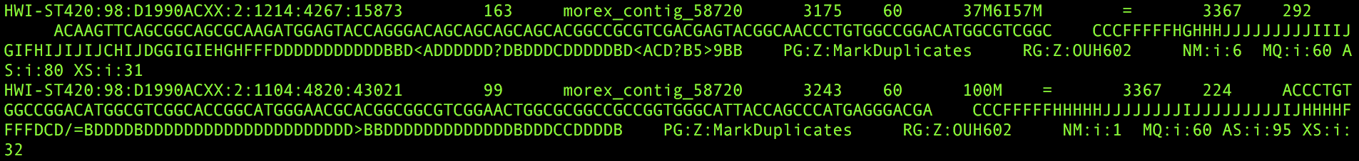
SAM content
Cite from https://samtools.github.io/hts-specs/SAMv1.pdf

Slide 7
Flag
Cite from https://samtools.github.io/hts-specs/SAMv1.pdf

Slide 8
Cigar code

Slide 9
Tools to handle SAM/BAM files
samtools
pysam

Slide 10
samtools: view, sort and index
SAM to BAM
samtools view –b celegans.sam >celegans.bam
BAM to SAM
samtools view celegans.bam >celegans_copy.sam
Sort
samtools sort celegans_unsorted.bam celegans_sorted
Index
samtools index celegans_sorted.bam
Notes:
Index will creat a .bai file
And the purpose is to create a hash table to convenient search

Slide 11
Visualizing SAM/BAM files
samtools tview
IGV
consed

Slide 12
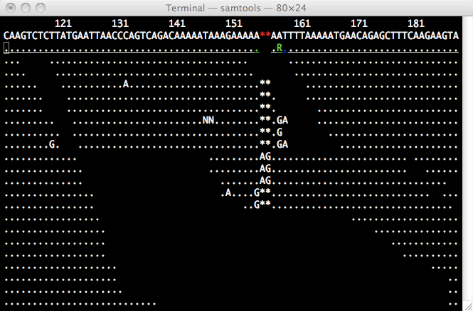
samtools tview
samtools tview celegans_sorted.bam celegans_reference.fasta
Notes:
The disadvantage is tview is: it can not give you the exact position. It will introduce the indels in the reference genome and give a wrong positions. So I don’t like tview

Slide 13
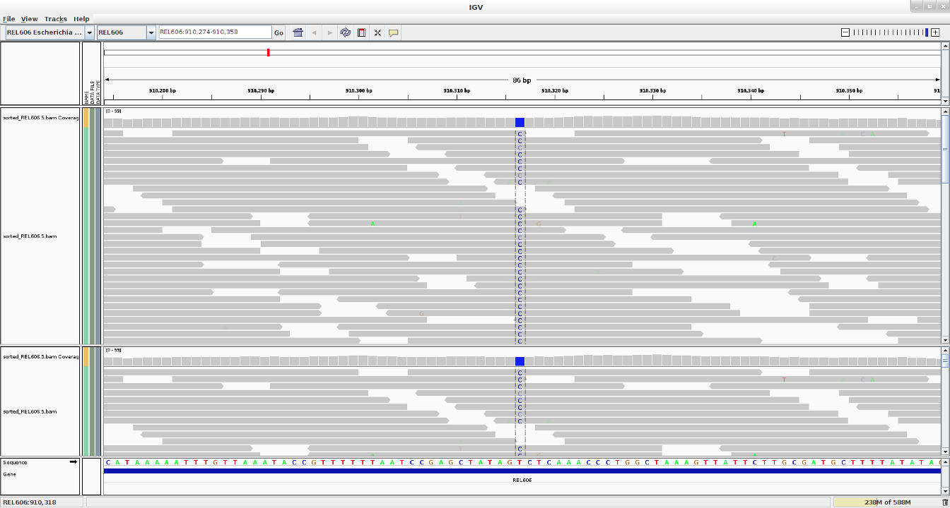
IGV
http://software.broadinstitute.org/software/igv/
Notes:
Graphic interphase and you can easily load the genome, but if the reference genome or your bam file is huge, it will become very slow.

Slide 14
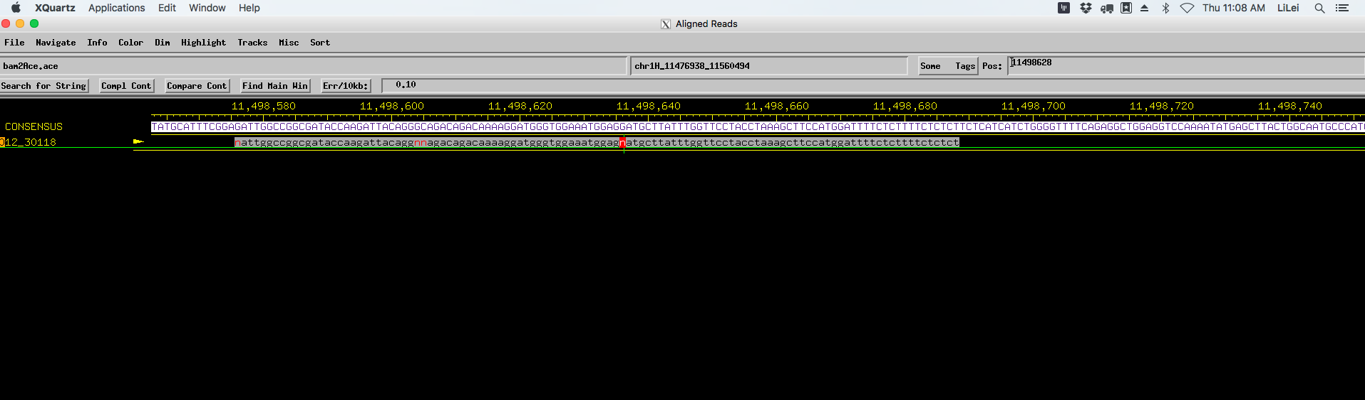
consed
http://www.phrap.org/consed/consed.html
Notes:
Consed, you can search the positions or motifs, but it is a little hard to have it work at the beginning

Slide 15
samtools tview, IGV and consed
samtools tview: can not give you the accurate position when there is indels in the mapped reads
IGV: if the genome or bam files are huge, it will be slow
consed: you can search the exact position or the motifs but a little hard to make it work

Slide 16
Call variants
GATK
samtools
samtools mpileup --no-BAQ --region 1:215906528-215906567 --fasta-ref human_g1k_v37.fasta NA12891_CEU_sample.bam
Notes:
We will give specifically session of GATK

Slide 17
VCF files
https://samtools.github.io/hts-specs/VCFv4.1.pdf
Notes:
Format to store the variants

Slide 18
Homework
Try to run the data in this link:
https://github.com/vsbuffalo/bds-files/tree/master/chapter-11-alignment

